Slide 1
C++
Structures

Slide 2

Iteration
There are ?? types of loops

Slide 3

Iteration
There are three types of loops:
For loops
While loops
Repeat until loops.

Slide 4

Types
While
For
Do … while

Slide 5
Flowcharts

Slide 6
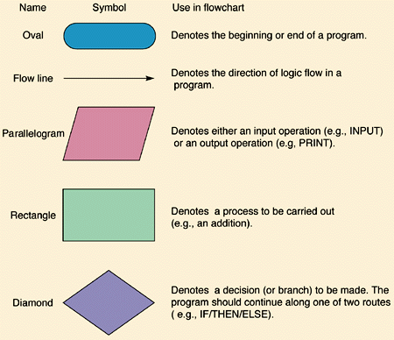

Slide 7
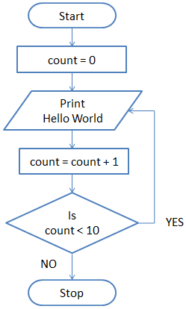
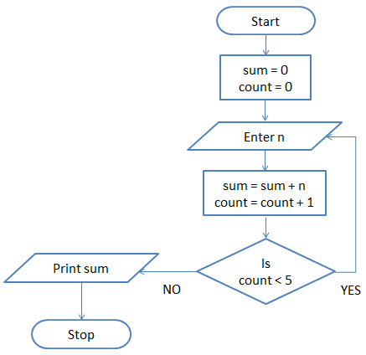

Slide 8
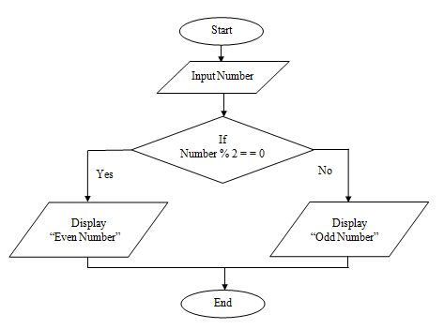


Slide 9
structs

Slide 10

The problem
You have a bunch of related data you want to store
E.g. An employees name, age (or d.o.b.) and salary.
Variables?
Arrays?
How to access?
Add phone number… ?

Slide 11
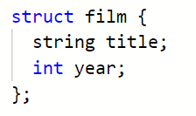

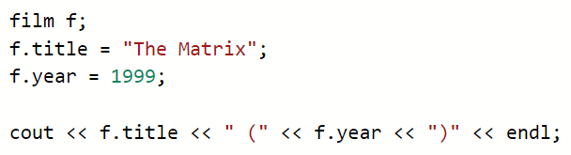

Solution – data structure

Slide 12
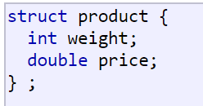

C++ structures
Data structure
Group of data elements grouped together under one name
Data elements are know as members

Slide 13
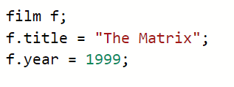


Use
Once declared structures are used like any other type

Slide 14
Task
Fill the film structure with 5 films,
Write a loop to output the films you have entered

Slide 15
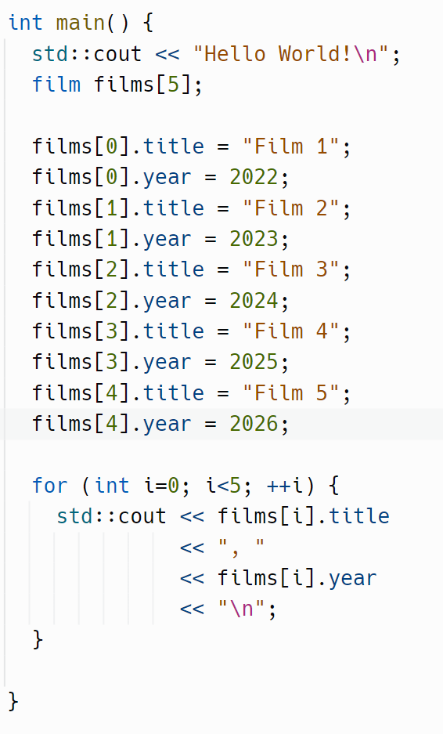
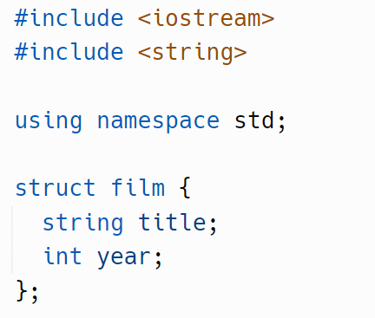

Slide 16
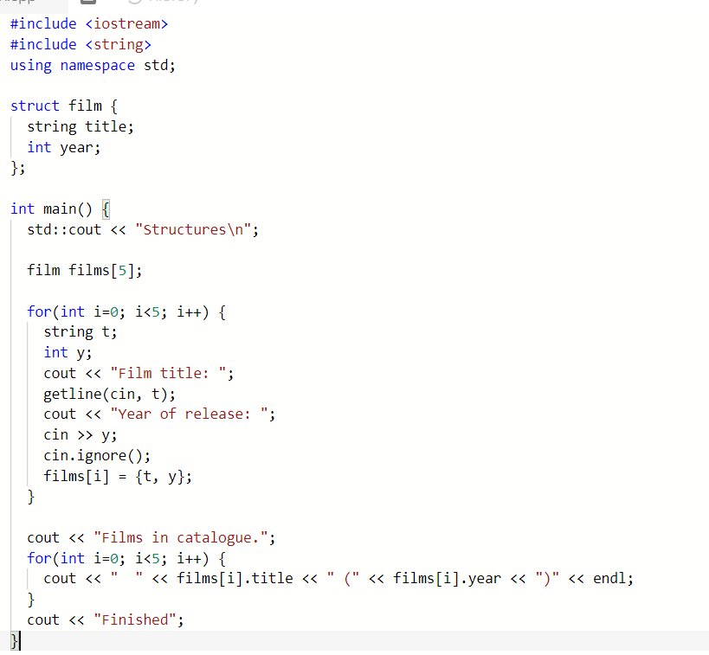

Using structures in a loop
See “Reading Line Of Text” handout for more details
Notes:
https://repl.it/@JohnGlazebrook/c-structures-read-from-file

Slide 17
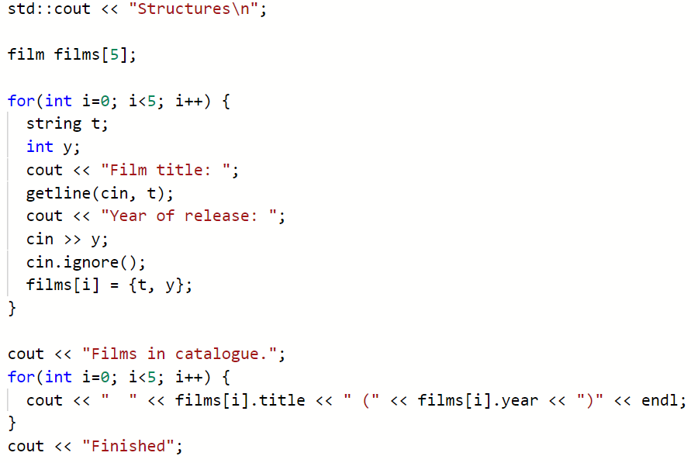
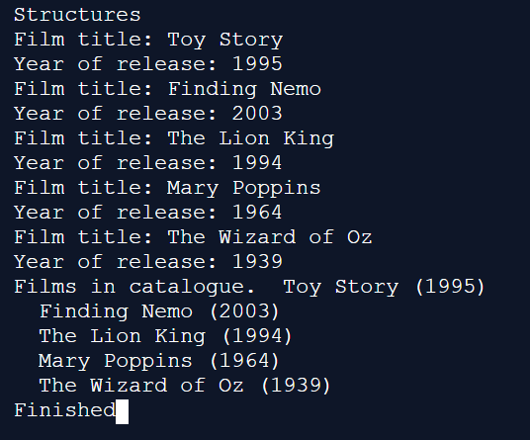


Slide 18
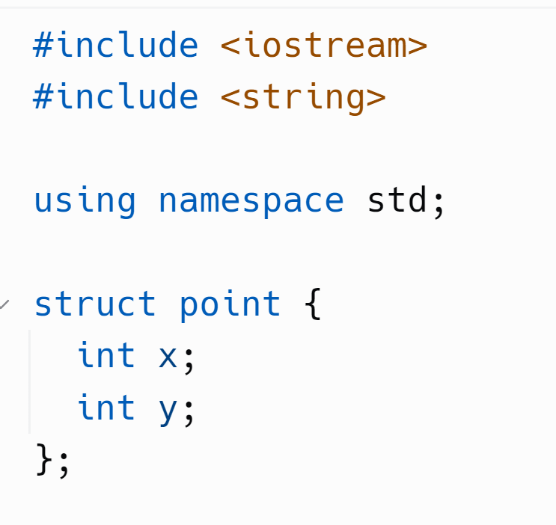
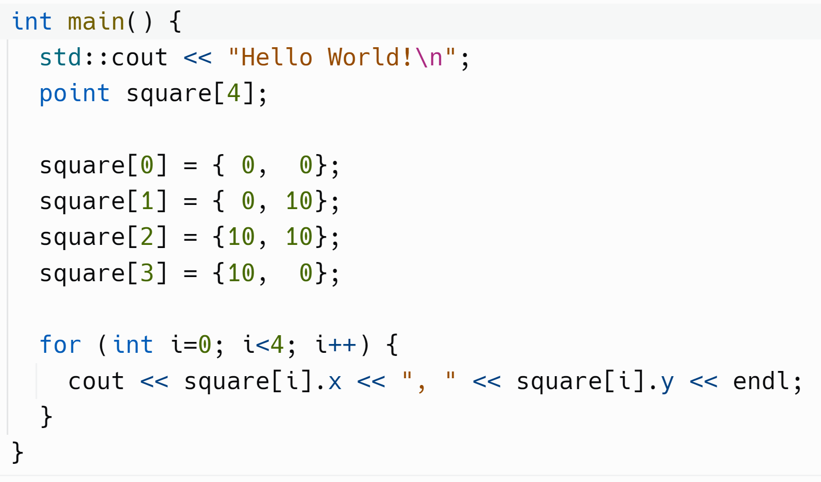
This will output the coordinates of a square.
Optional Task – can you draw this square on the command line?

Slide 19

Tasks for this morning:
Read and research arrays and strings
Complete the structs worksheet
C++ bank interest is due in today
There will be time later to work on it.
Notes:
https://repl.it/@JohnGlazebrook/c-structs-20
https://repl.it/@JohnGlazebrook/c-structures-read-from-file
https://repl.it/@JohnGlazebrook/c-structures
https://repl.it/@JohnGlazebrook/c-structs-array

